Slide 1
Chapter 24 Single-Source Shortest Paths
Chi-Yeh Chen
陳奇業
成功大學資訊工程學系

Slide 2
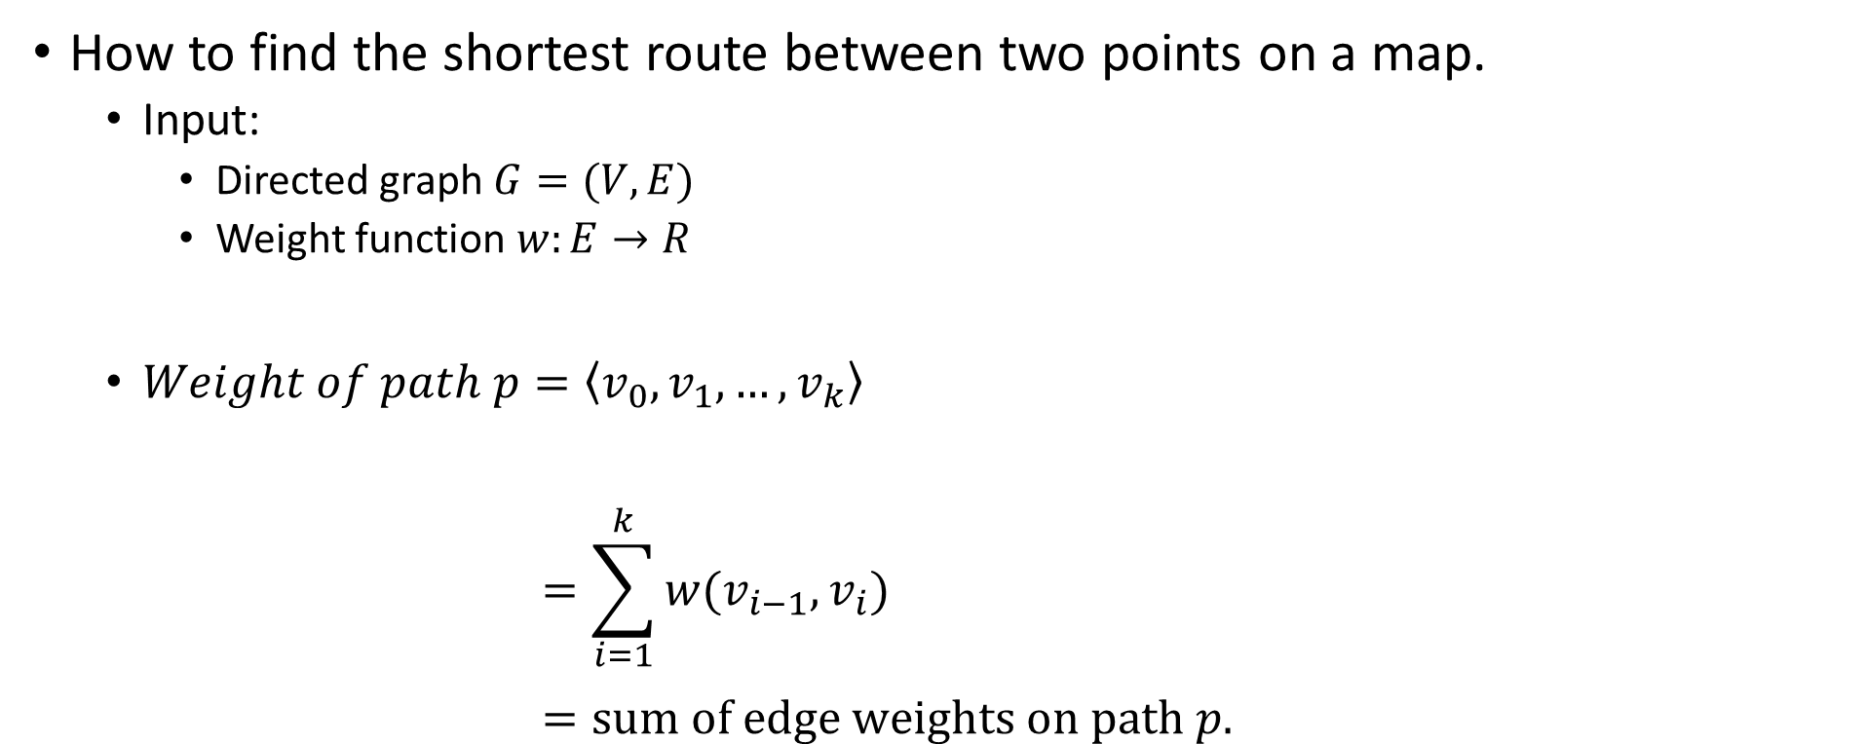
Shortest paths
How to find the shortest route between two points on a map.
Input:
Directed graph $G=(V,E)$
Weight function $w:E→R$
$Weight of path p=\left\langle v_{0},v_{1},…,v_{k}\right\rangle$ $=\sum_{i=1}^{k}{w(v_{i−1},v_{i})}$ $=sum of edge weights on path p.$

Slide 3






Shortest-path weight $u$ to $v$ :
$δ\left(u,v\right)=\left\{\begin{aligned}\min\left\{w\left(p\right):u↝v\right\}, if there exists a path u↝v \\ ∞,otherwise\end{aligned}\right.$
Shortest path $u$ to $v$is any path p such that $w\left(p\right)=δ(u,v)$.
$$p$$

Slide 4
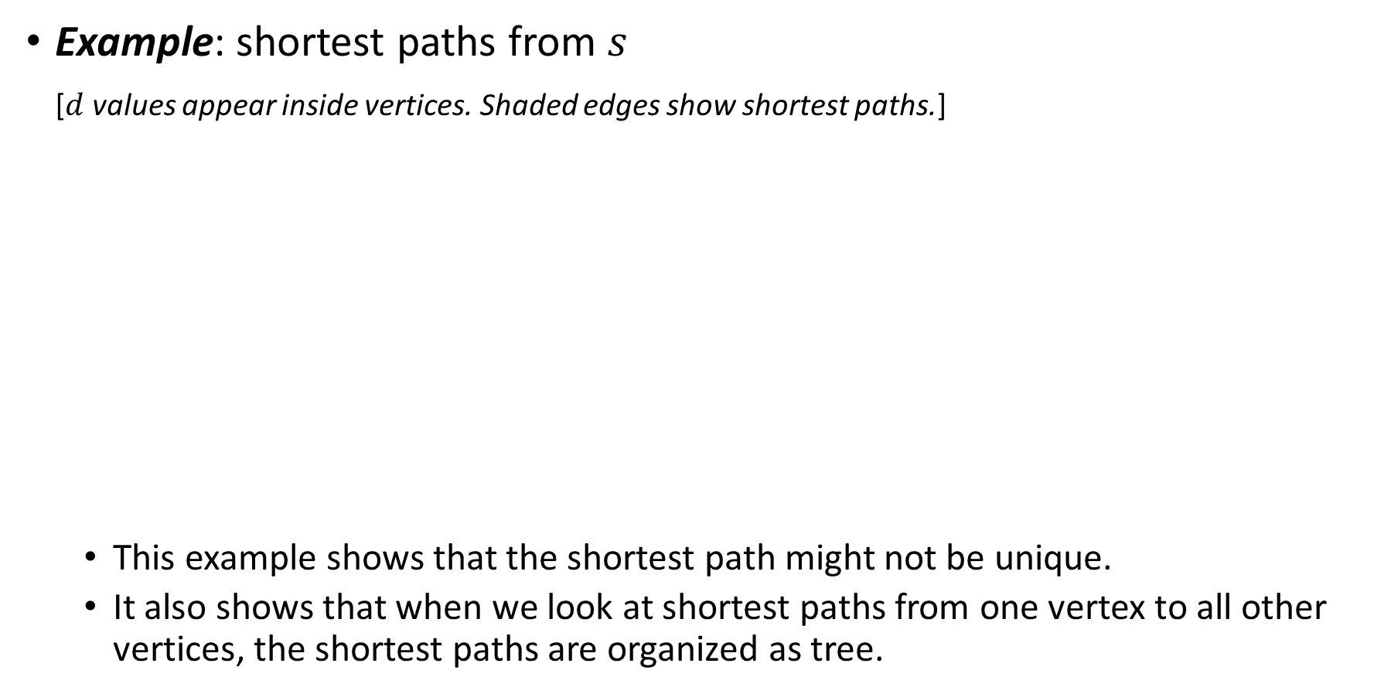
Example: shortest paths from $s$
[$d$ values appear inside vertices. Shaded edges show shortest paths.]
This example shows that the shortest path might not be unique.
It also shows that when we look at shortest paths from one vertex to all other vertices, the shortest paths are organized as tree.

Slide 5
Can think of weights as representing any measure that
accumulates linearly along a path.
we want to minimize.
Example: time, cost, penalties, loss.
Generalization of breadth-first search to weighted graphs.

Slide 6
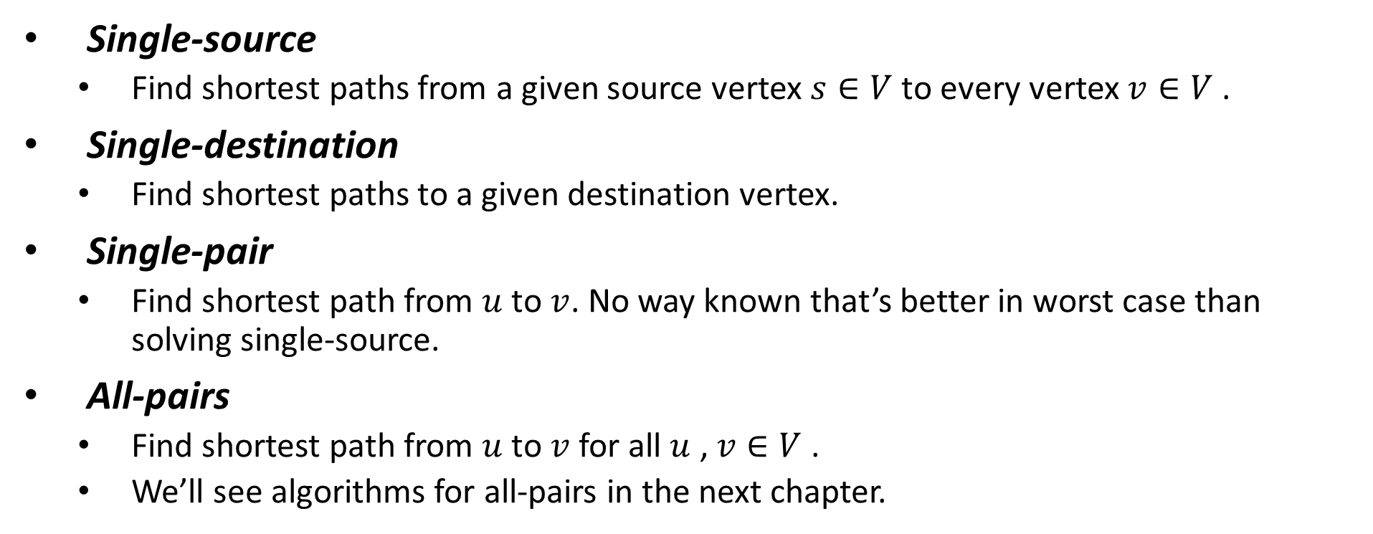
Variants
Single-source
Find shortest paths from a given source vertex $s∈V$ to every vertex $v∈V$ .
Single-destination
Find shortest paths to a given destination vertex.
Single-pair
Find shortest path from $u$ to $v$. No way known that’s better in worst case than solving single-source.
All-pairs
Find shortest path from $u$ to $v$ for all $u$ , $v∈V$ .
We’ll see algorithms for all-pairs in the next chapter.

Slide 7
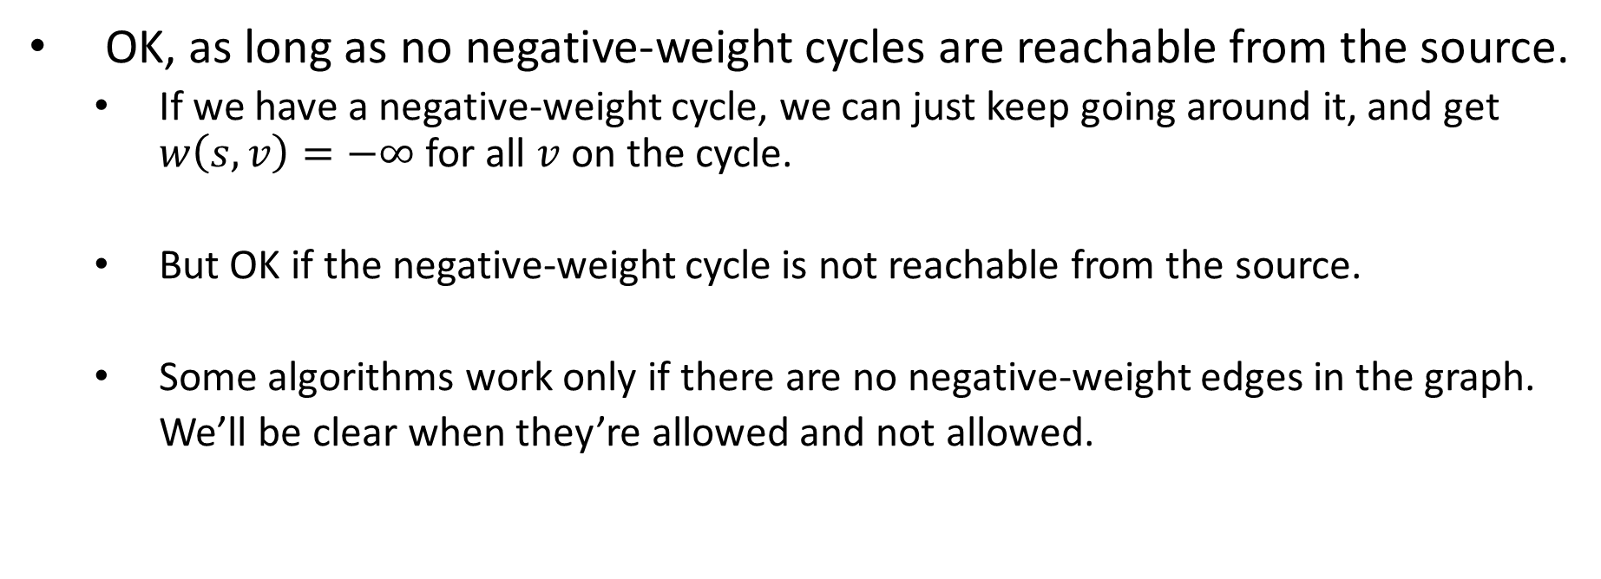
Negative-weight edges
OK, as long as no negative-weight cycles are reachable from the source.
If we have a negative-weight cycle, we can just keep going around it, and get $w\left(s,v\right)=−∞$ for all $v$ on the cycle.
But OK if the negative-weight cycle is not reachable from the source.
Some algorithms work only if there are no negative-weight edges in the graph.
We’ll be clear when they’re allowed and not allowed.

Slide 8



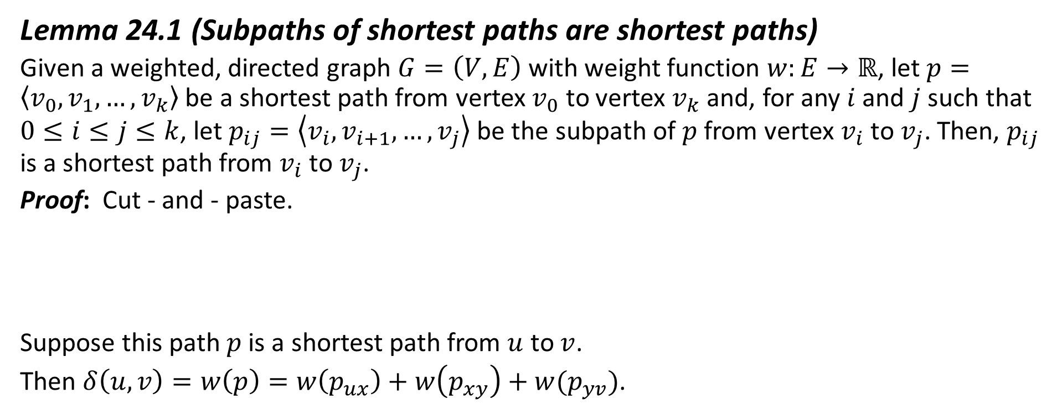




Optimal substructure
Lemma 24.1 (Subpaths of shortest paths are shortest paths)
Given a weighted, directed graph $G=\left(V, E\right)$ with weight function $w:E→ℝ$, let $p=\left\langle v_{0},v_{1}, …,v_{k}\right\rangle$ be a shortest path from vertex $v_{0}$ to vertex $v_{k}$ and, for any $i$ and $j$ such that $0≤i≤j≤k$, let $p_{ij}=\left\langle v_{i},v_{i+1}, …,v_{j}\right\rangle$ be the subpath of $p$ from vertex $v_{i}$ to $v_{j}$. Then, $p_{ij}$ is a shortest path from $v_{i}$ to $v_{j}$.
Proof: Cut - and - paste.
Suppose this path $p$ is a shortest path from $u$ to $v$.
Then $δ\left(u,v\right)=w\left(p\right)=w\left(p_{ux}\right)+w\left(p_{xy}\right)+w(p_{yv})$.
$$p_{ux}$$
$$p_{xy}$$
$$p_{yv}$$
$$u$$
$$x$$
$$y$$
$$v$$

Slide 9




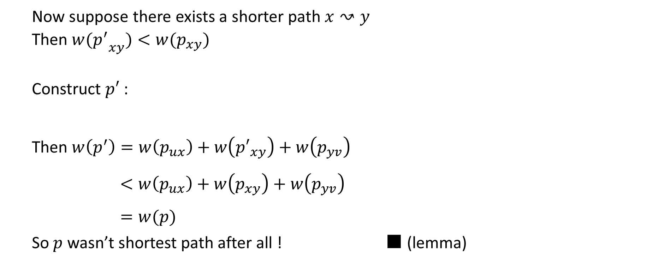




$${P′}_{xy}$$
Now suppose there exists a shorter path $x↝y$
Then $w({p^{′}}_{xy})<w(p_{xy})$
Construct $p′$ :
Then $w\left(p^{′}\right)=w\left(p_{ux}\right)+w\left({p′}_{xy}\right)+w\left(p_{yv}\right)$ $<w\left(p_{ux}\right)+w\left(p_{xy}\right)+w\left(p_{yv}\right)$ $=w(p)$
So $p$ wasn’t shortest path after all ! ■ (lemma)
$$p_{ux}$$
$${p′}_{xy}$$
$$p_{yv}$$
$$u$$
$$x$$
$$y$$
$$v$$

Slide 10
Cycles
Shortest paths can’t contain cycles :
Already ruled out negative-weight cycles.
Positive-weight ⇒ we can get a shorter path by omitting the cycle.
Zero-weight: no reason to use them ⇒ assume that our solutions won’t use them.

Slide 11
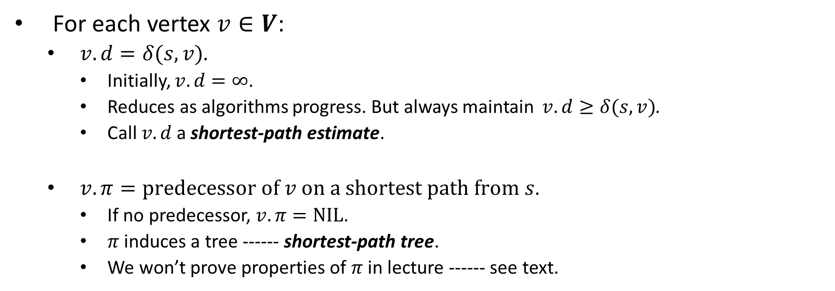
Output of single-source shortest-path algorithm
For each vertex $v∈V$:
$v.d=δ(s,v)$.
Initially, $v.d=∞$.
Reduces as algorithms progress. But always maintain $v.d≥δ(s,v)$.
Call $v.d$ a shortest-path estimate.
$v.π=predecessor of v on a shortest path from s$.
If no predecessor, $v.π=NIL$.
$π$ induces a tree ------ shortest-path tree.
We won’t prove properties of $π$ in lecture ------ see text.

Slide 12
Initialization
All the shortest-paths algorithms start with
INITIALIZE-SINGLE-SOURCE.

Slide 13


Relaxing an edge $(u, v)$
Can we improve the shortest-path estimate for $v$ by going through $u$ and taking $(u, v)$?

Slide 14
For all the single-source shortest-paths algorithms we’ll look at,
start by calling INITIALIZE-SINGLE-SOURCE,
then relax edges.
The algorithms differ in the order and how many times they relax each edge.

Slide 15


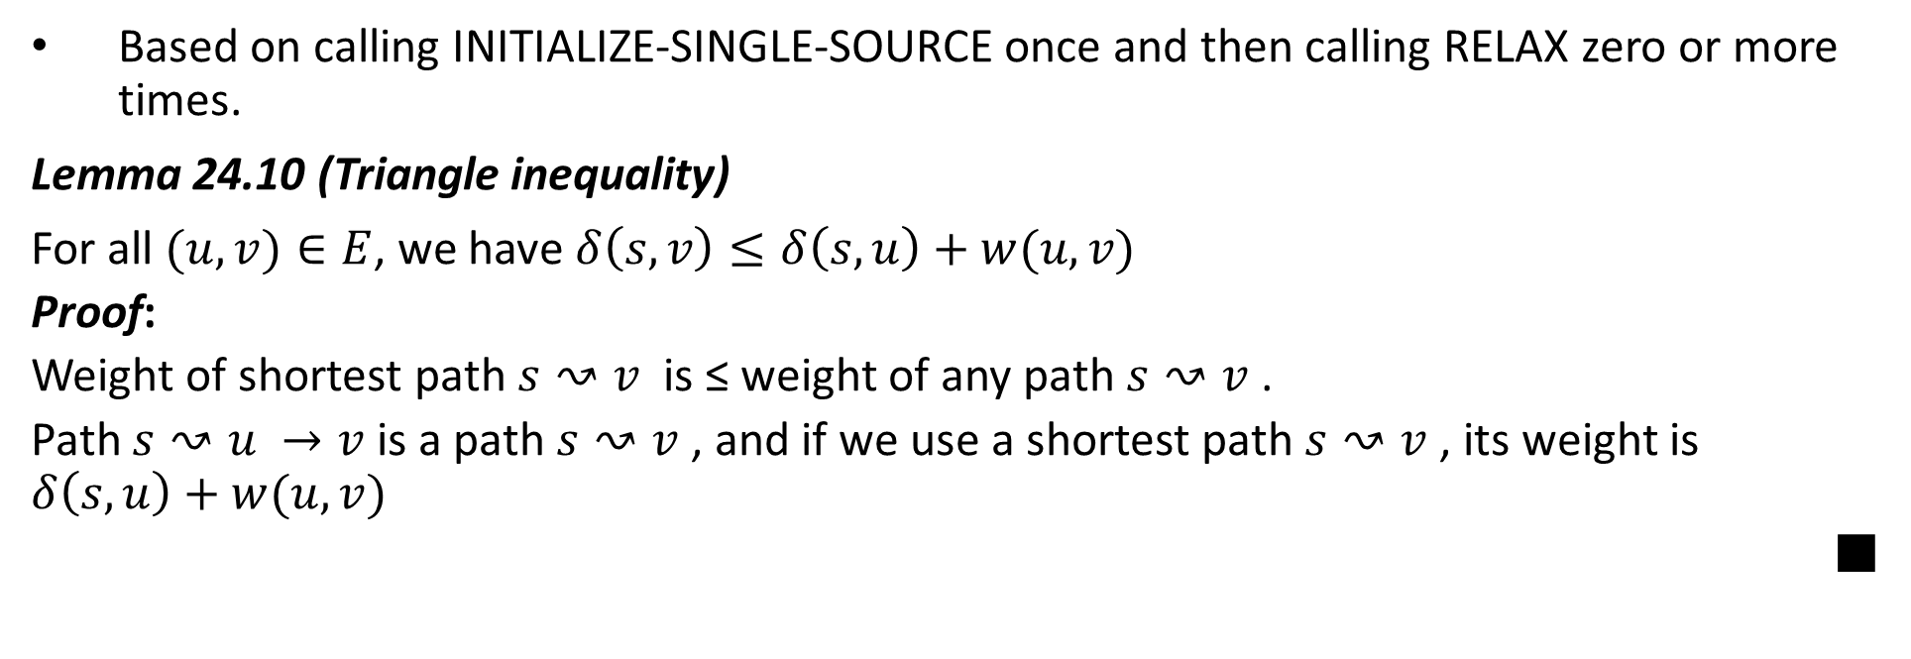

Shortest-paths properties
Based on calling INITIALIZE-SINGLE-SOURCE once and then calling RELAX zero or more times.
Lemma 24.10 (Triangle inequality)
For all $(u,v)∈E$, we have $δ\left(s,v\right)≤δ\left(s,u\right)+w(u,v)$
Proof:
Weight of shortest path $s↝v$ is ≤ weight of any path $s↝v$.
Path $s↝u →v$ is a path $s↝v$, and if we use a shortest path $s↝v$, its weight is $δ\left(s,u\right)+w(u,v)$
■
$(s,u$)
u
$$w(u,v)$$
s
v
$$(s,v)$$

Slide 16
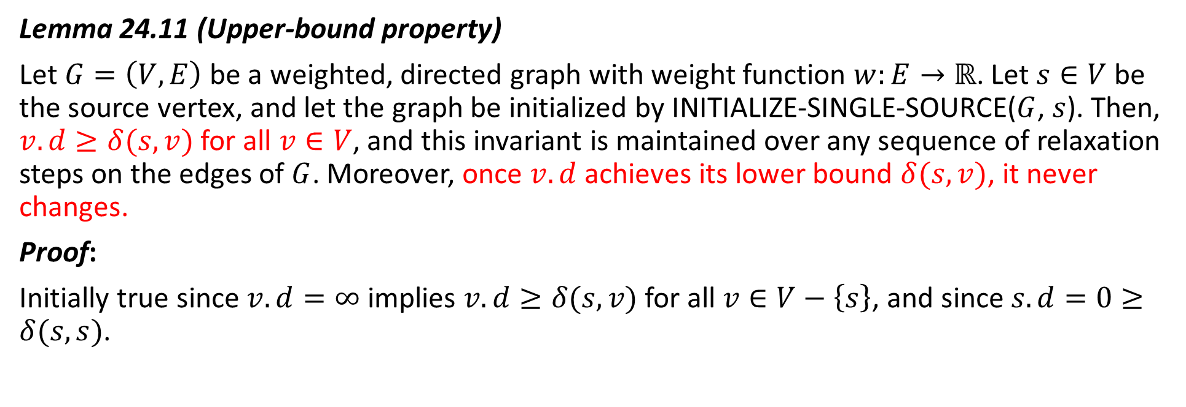
Upper-bound property
Lemma 24.11 (Upper-bound property)
Let $G=\left(V, E\right)$ be a weighted, directed graph with weight function $w:E→ℝ$. Let $s∈V$ be the source vertex, and let the graph be initialized by INITIALIZE-SINGLE-SOURCE($G$, $s$). Then, $v.d≥δ(s,v)$ for all $v∈V$, and this invariant is maintained over any sequence of relaxation steps on the edges of $G$. Moreover, once $v.d$ achieves its lower bound $δ(s,v)$, it never changes.
Proof:
Initially true since $v.d=∞$ implies $v.d≥δ(s,v)$ for all $v∈V−\left\{s\right\}$, and since $s.d=0≥δ(s,s)$.

Slide 17
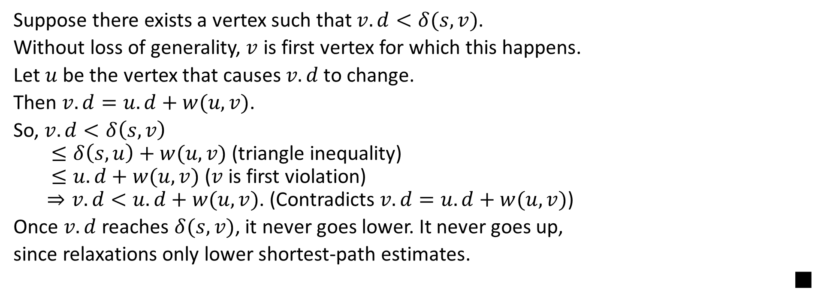
Suppose there exists a vertex such that $v.d<δ(s,v)$.
Without loss of generality, $v$ is first vertex for which this happens.
Let $u$ be the vertex that causes $v.d$to change.
Then $v.d=u.d+w(u,v)$.
So, $v.d<δ\left(s,v\right)$ $≤δ\left(s,u\right)+w(u,v)$ (triangle inequality) $≤u.d+w(u,v)$ ($v$ is first violation) $⇒v.d<u.d+w(u,v)$. (Contradicts $v.d=u.d+w(u, v)$)
Once $v.d$ reaches $δ(s, v)$, it never goes lower. It never goes up,
since relaxations only lower shortest-path estimates.
■

Slide 18
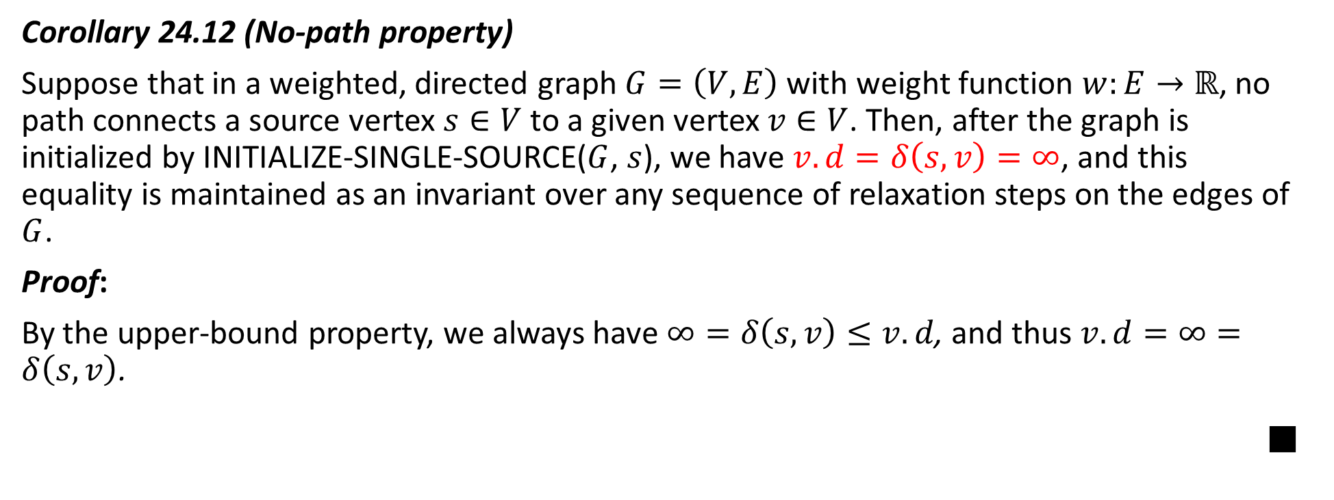
No-path property
Corollary 24.12 (No-path property)
Suppose that in a weighted, directed graph $G=\left(V, E\right)$ with weight function $w:E→ℝ$, no path connects a source vertex $s∈V$ to a given vertex $v∈V$. Then, after the graph is initialized by INITIALIZE-SINGLE-SOURCE($G$, $s$), we have $v.d=δ\left(s, v\right)=∞$, and this equality is maintained as an invariant over any sequence of relaxation steps on the edges of $G$.
Proof:
By the upper-bound property, we always have $∞=δ\left(s, v\right)≤v.d$, and thus $v.d=∞=δ\left(s, v\right)$.
■

Slide 19
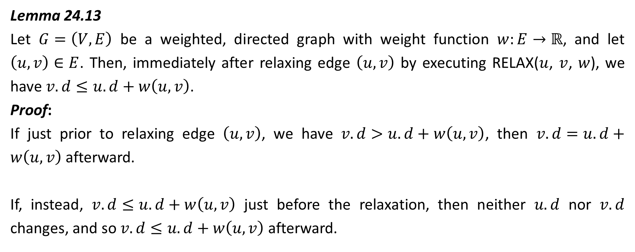
Lemma 24.13
Let $G=\left(V, E\right)$ be a weighted, directed graph with weight function $w:E→ℝ$, and let $\left(u, v\right)∈E$. Then, immediately after relaxing edge $\left(u, v\right)$ by executing RELAX($u$, $v$, $w$), we have $v.d≤u.d+w\left(u, v\right)$.
Proof:
If just prior to relaxing edge $\left(u, v\right)$, we have $v.d>u.d+w\left(u, v\right)$, then $v.d=u.d+w\left(u, v\right)$ afterward.
If, instead, $v.d≤u.d+w\left(u, v\right)$ just before the relaxation, then neither $u.d$ nor $v.d$ changes, and so $v.d≤u.d+w\left(u, v\right)$ afterward.

Slide 20
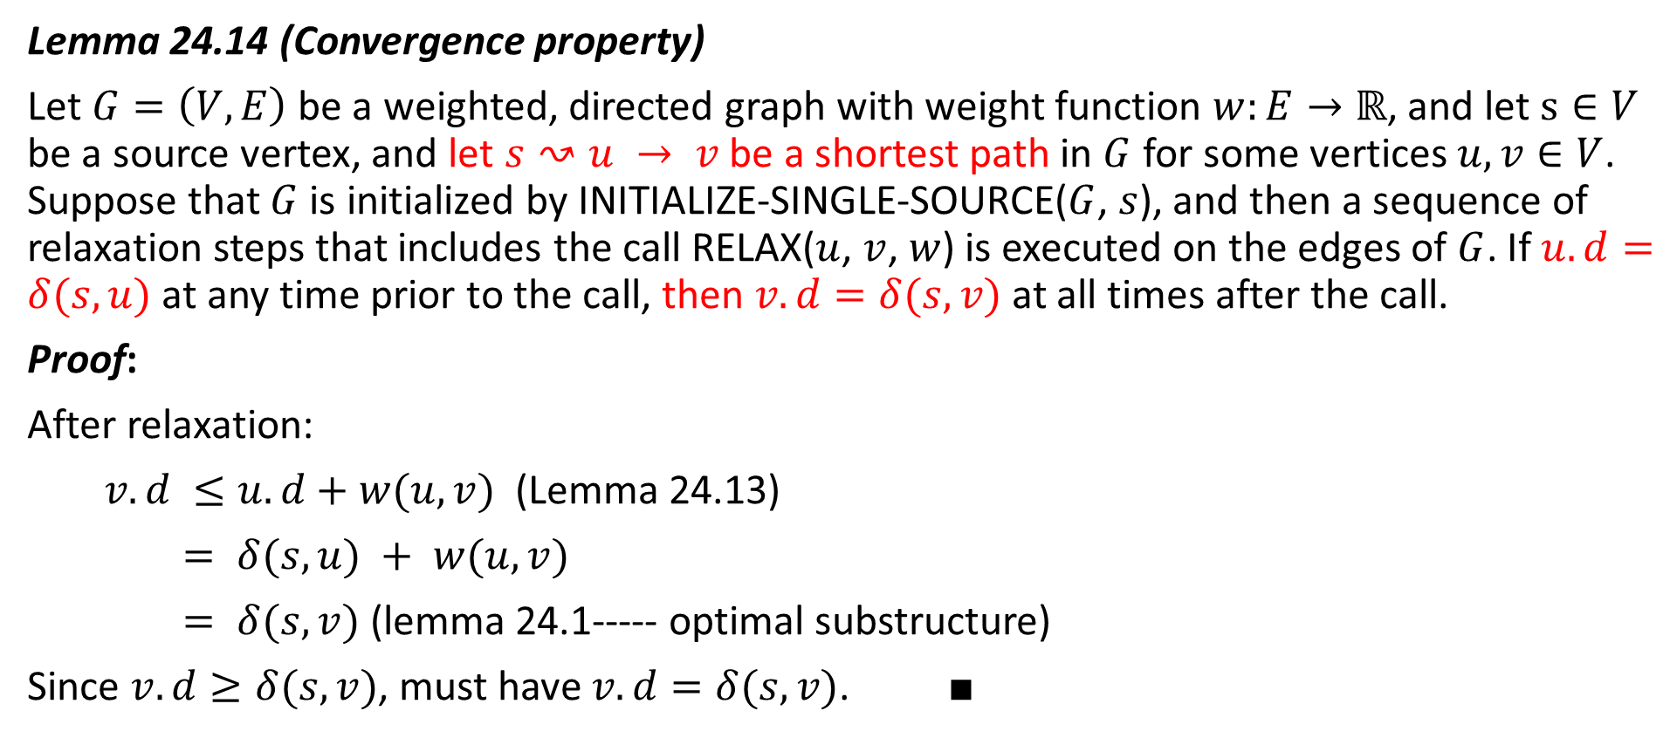
Convergence property
Lemma 24.14 (Convergence property)
Let $G=\left(V, E\right)$ be a weighted, directed graph with weight function $w:E→ℝ$, and let $s∈V$ be a source vertex, and let $s↝u → v$be a shortest path in $G$ for some vertices $u, v∈V$. Suppose that $G$ is initialized by INITIALIZE-SINGLE-SOURCE($G$, $s$), and then a sequence of relaxation steps that includes the call RELAX($u$, $v$, $w$) is executed on the edges of $G$. If $u.d=δ(s, u)$ at any time prior to the call, then $v.d=δ(s, v)$ at all times after the call.
Proof:
After relaxation:
$v.d ≤u.d+w(u, v)$(Lemma 24.13)
$= δ(s, u) + w(u, v)$
$= δ(s, v)$(lemma 24.1----- optimal substructure)
Since $v.d≥δ(s, v)$, must have $v.d=δ(s, v)$. ■

Slide 21
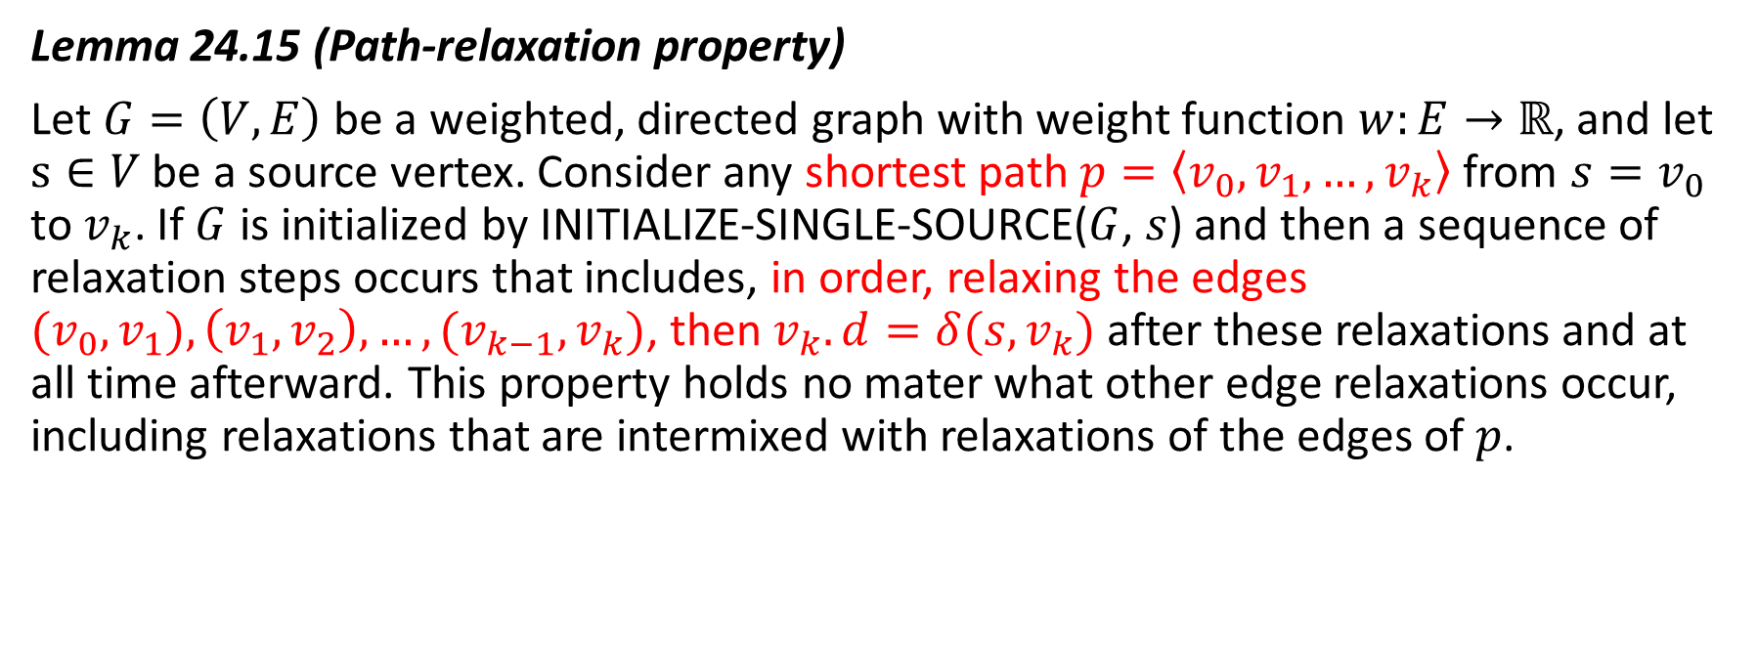
Path relaxation property
Lemma 24.15 (Path-relaxation property)
Let $G=\left(V, E\right)$ be a weighted, directed graph with weight function $w:E→ℝ$, and let $s∈V$ be a source vertex. Consider any shortest path $p=\left\langle v_{0},v_{1},…,v_{k}\right\rangle$ from $s=v_{0}$ to $v_{k}$. If $G$ is initialized by INITIALIZE-SINGLE-SOURCE($G$, $s$) and then a sequence of relaxation steps occurs that includes, in order, relaxing the edges $(v_{0},v_{1}),\left(v_{1},v_{2}\right),…,{(v}_{k−1},v_{k})$, then $v_{k}. d=δ(s,v_{k})$ after these relaxations and at all time afterward. This property holds no mater what other edge relaxations occur, including relaxations that are intermixed with relaxations of the edges of $p$.

Slide 22
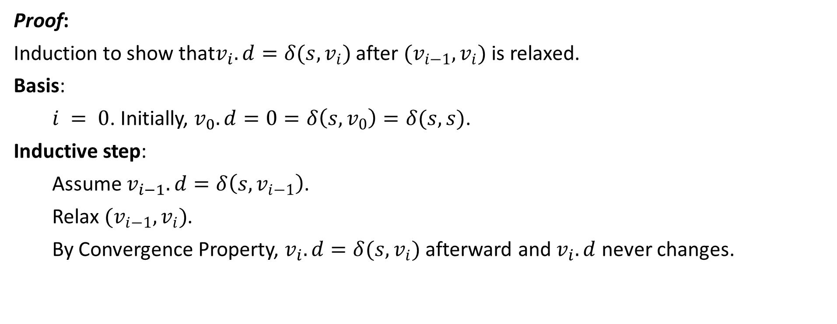
Proof:
Induction to show that$v_{i}.d=δ(s,v_{i})$ after ${(v}_{i−1},v_{i})$ is relaxed.
Basis:
$i = 0$. Initially, $v_{0}.d=0=δ\left(s,v_{0}\right)=δ(s,s)$.
Inductive step:
Assume $v_{i−1}.d=δ\left(s,v_{i−1}\right)$.
Relax ${(v}_{i−1},v_{i})$.
By Convergence Property, $v_{i}.d=δ(s,v_{i})$ afterward and $v_{i}.d$ never changes.

Slide 23
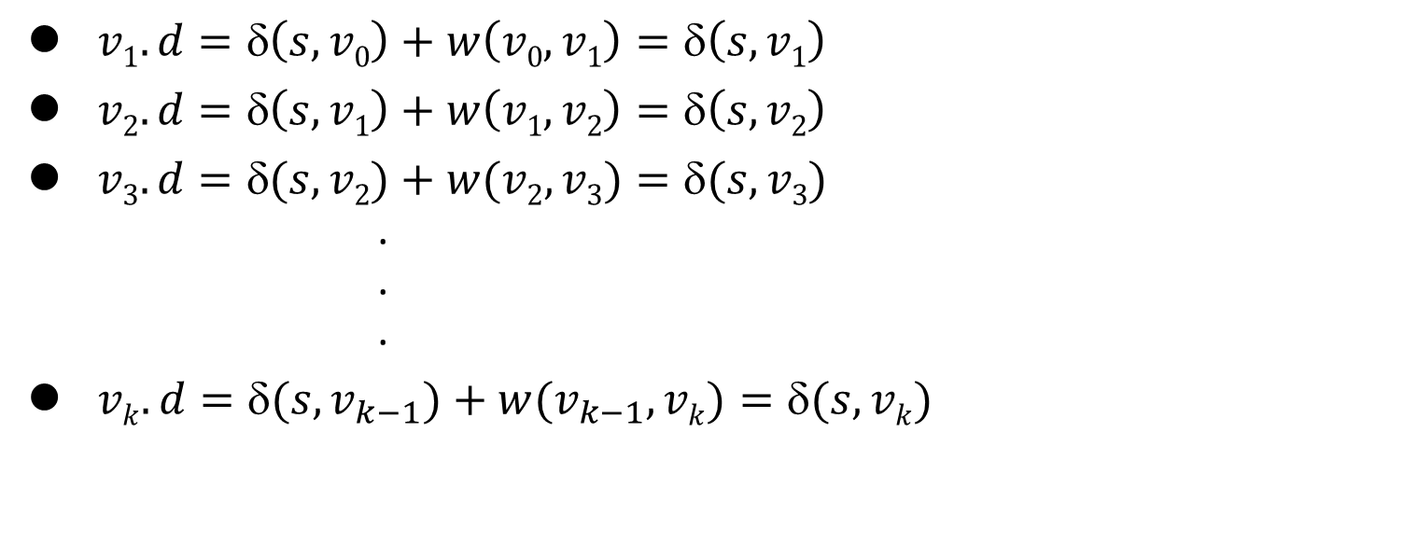
v₀
v₁
v₂
v₃
v_{k-1}
v_{k}
$v1.d=δ\left(s,v0\right)+w\left(v0,v1\right)=δ\left(s,v1\right)$
$v2.d=δ\left(s,v1\right)+w\left(v1,v2\right)=δ\left(s,v2\right)$
$v3.d=(s,v2)+w(v2,v3)=(s,v3)$ . . .
$vk.d=(s,v_{k−1})+w(v_{k−1}, vk)=(s,vk)$

Slide 24
The Bellman-Ford algorithm

Slide 25
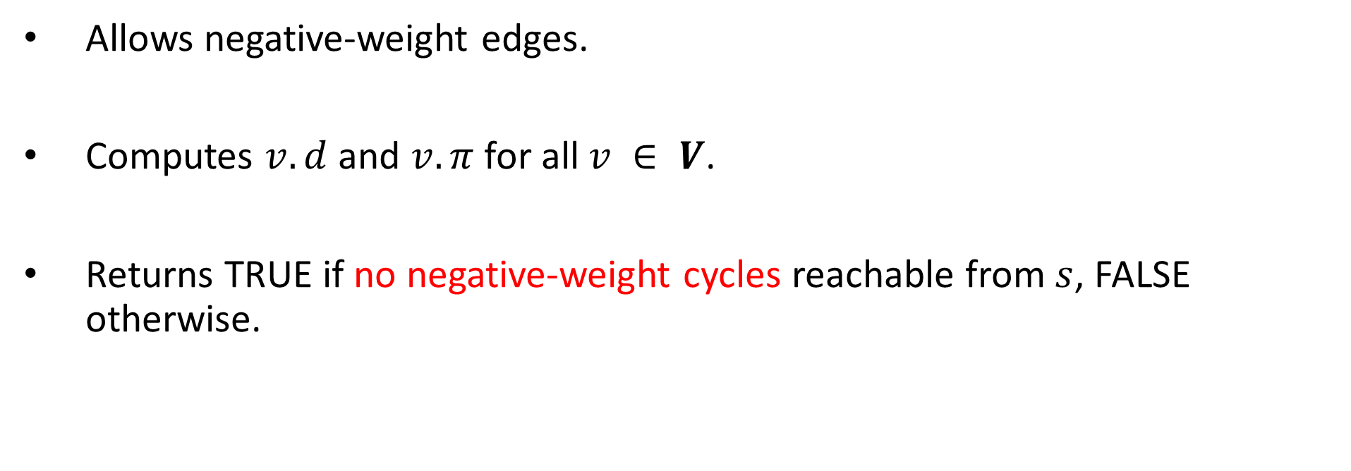
The Bellman-Ford algorithm
Allows negative-weight edges.
Computes $v.d$ and $v.π$ for all $v ∈ V$.
Returns TRUE if no negative-weight cycles reachable from $s$, FALSE otherwise.

Slide 26
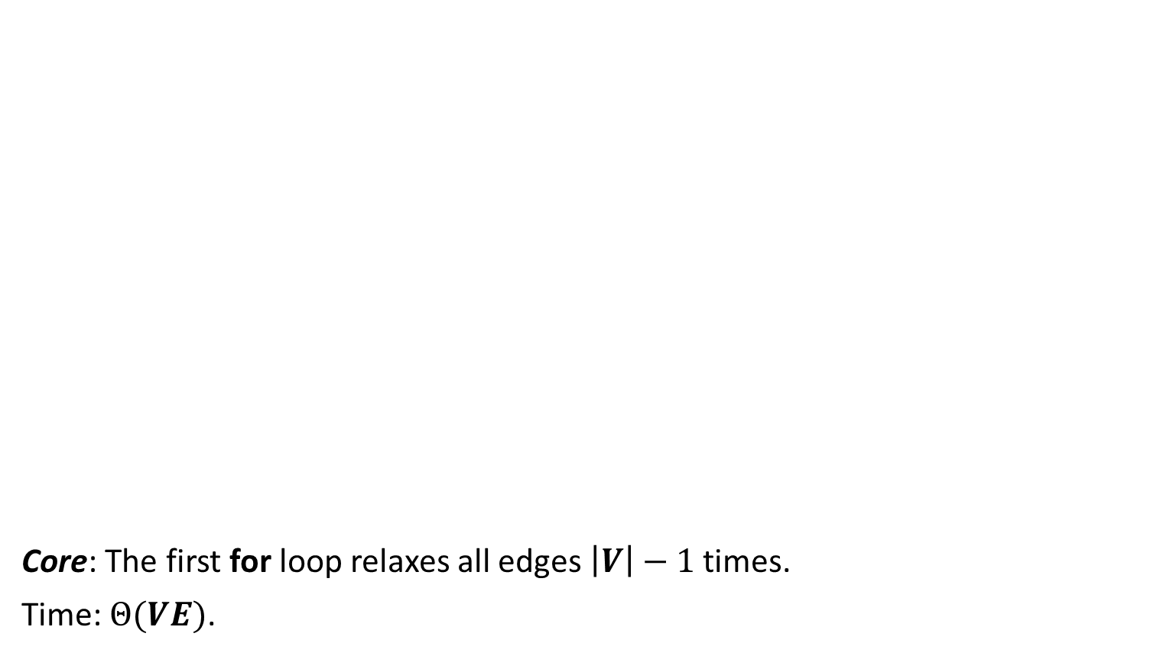
Core: The first for loop relaxes all edges $\left|V\right|−1$ times.
Time: $Θ(VE)$.

Slide 27
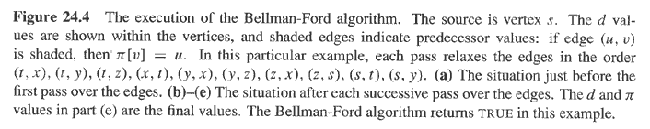

$i = 1$
t
x
5
6
∞
∞
6
-2
-3
s
0
8
7
-4
2
7
∞
7
∞
9
y
z

Slide 28

$i =2$
t
x
5
6
∞
4
11
6
-2
-3
s
0
8
7
-4
2
7
7
∞
2
9
y
z

Slide 29

$i =3$
t
x
5
6
2
4
6
-2
-3
s
0
8
7
-4
2
7
7
2
9
y
z

Slide 30

$i =4$
t
x
5
2
4
6
-2
-3
s
0
8
7
-4
2
7
7
-2
2
9
y
z

Slide 31
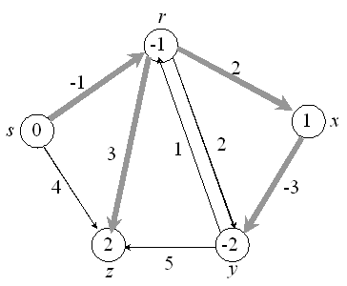

Example:
Values you get on each pass and how quickly it converges depends on order of relaxation.
But guaranteed to converge after $\left|V\right|−1$passes, assuming no negative-weight cycles.

Slide 32
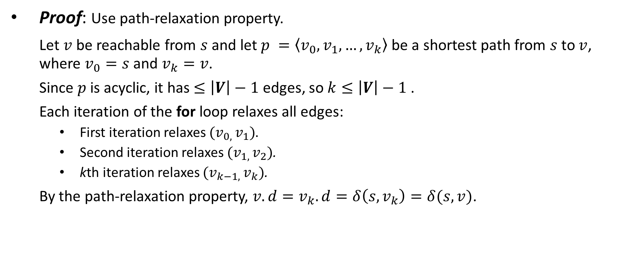
Proof: Use path-relaxation property.
Let $v$ be reachable from $s$ and let $p =\left\langle v_{0},v_{1},…,v_{k}\right\rangle$ be a shortest path from $s$ to $v$, where $v_{0}=s$ and $v_{k}=v$.
Since $p$ is acyclic, it has $≤\left|V\right|−1$edges, so $k≤\left|V\right|−1$.
Each iteration of the for loop relaxes all edges:
First iteration relaxes ${(v}_{0, }v_{1})$.
Second iteration relaxes ${(v}_{1, }v_{2})$.
kth iteration relaxes ${(v}_{k−1, }v_{k})$.
By the path-relaxation property, $v.d=v_{k}.d=δ\left(s,v_{k}\right)=δ(s,v)$.

Slide 33
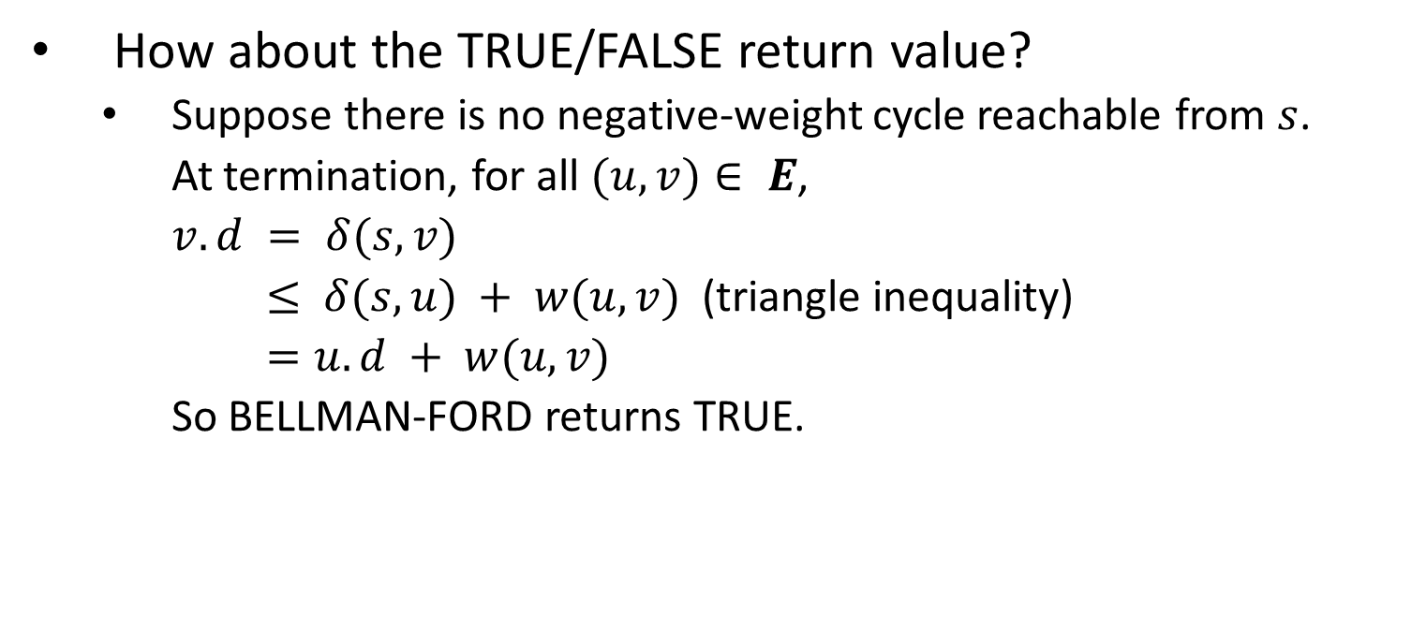
How about the TRUE/FALSE return value?
Suppose there is no negative-weight cycle reachable from $s$.
At termination, for all $(u, v)∈ E$,
$v.d = δ(s, v)$
$≤ δ(s, u) + w(u, v)$(triangle inequality)
$=u.d + w(u, v)$
So BELLMAN-FORD returns TRUE.

Slide 34
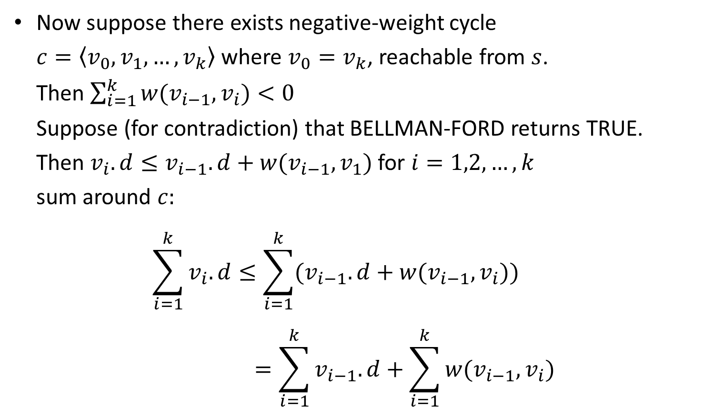
Now suppose there exists negative-weight cycle $c=\left\langle v_{0},v_{1},…,v_{k}\right\rangle$ where $v_{0}=v_{k}$, reachable from $s$. Then $\sum_{i=1}^{k}{w(v_{i−1},v_{i}})<0$ Suppose (for contradiction) that BELLMAN-FORD returns TRUE. Then $v_{i}.d≤v_{i−1}.d+w(v_{i−1},v_{1})$ for $i=1,2,…,k$ sum around $c:$ $\sum_{i=1}^{k}{v_{i}.d}≤\sum_{i=1}^{k}{(v_{i−1}.d}+w(v_{i−1},v_{i}))$ $=\sum_{i=1}^{k}{v_{i−1}.d}+\sum_{i=1}^{k}{w(v_{i−1},v_{i})}$

Slide 35

Each vertex appears once in each summation $\sum_{i=1}^{k}{v_{i}.d}$ and $\sum_{i=1}^{k}{v_{i−1}.d}$.
⇒ $0≤\sum_{i=1}^{k}{w(v_{i−1},v_{i})}$.
This contradicts $C$ being a negative-weight cycle!
■

Slide 36
Single-source shortest paths in a directed acyclic graph

Slide 37
Single-source shortest paths in a directed acyclic graph
Since a dag, we’re guaranteed no negative-weight cycles.

Slide 38
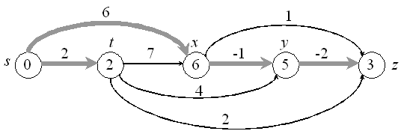
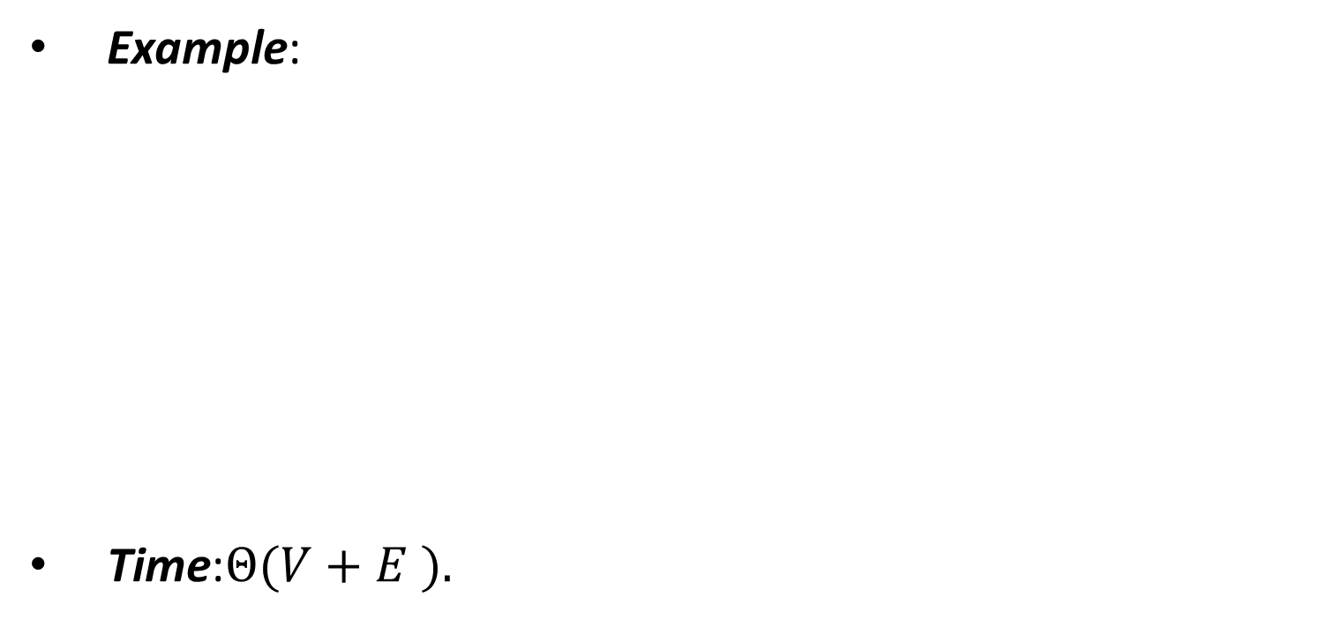
Example:
Time:$Θ(V+E ).$

Slide 39
6
1
r
s
t
x
y
z
5
2
7
-1
6
-2
5
∞
5
∞
0
0
∞
∞
2
2
∞
6
∞
4
3
6
3
3
4
2
Figure 24.5 The execution of the algorithm for shortest paths in a directed acyclic graph.
The vertices are topologically sorted from left to right. The source vertex is s.
The d values are shown within the vertices, and shaded edges indicate the π values.

Slide 40
Correctness: Because we process vertices in topologically sorted order, edges of any path must be relaxed in order of appearance in the path.
⇒ Edges on any shortest path are relaxed in order.
⇒ By path-relaxation property, correct.
■

Slide 41
Dijkstra’s algorithm

Slide 42
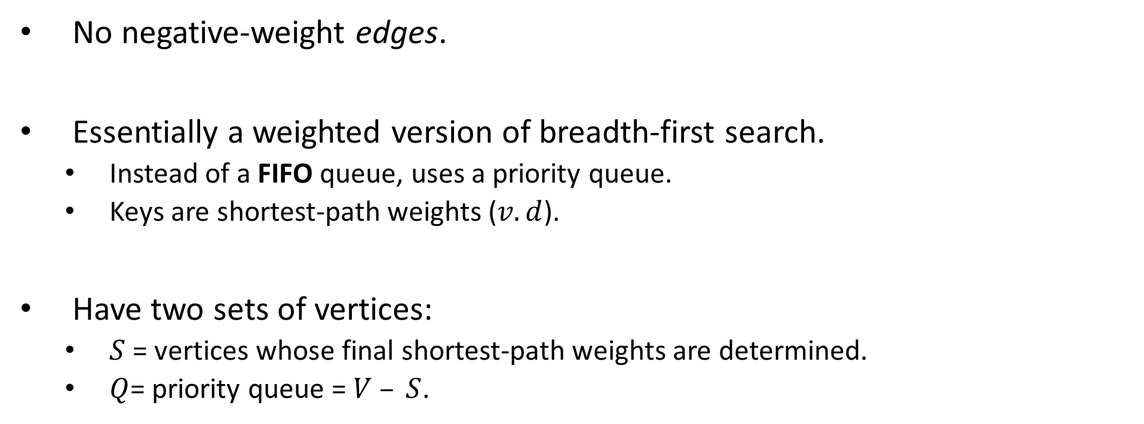
Dijkstra’s algorithm
No negative-weight edges.
Essentially a weighted version of breadth-first search.
Instead of a FIFO queue, uses a priority queue.
Keys are shortest-path weights ($v.d$).
Have two sets of vertices:
$S$ = vertices whose final shortest-path weights are determined.
$Q$= priority queue = $V – S$.

Slide 43

Like Prim’s algorithm, but computing $v.d$, and using shortest-path weights as keys.
Dijkstra’s algorithm can be viewed as greedy, since it always chooses the “lightest” (“closest”?) vertex in $V–S$to add to $S$.

Slide 44
u
u
u
u
u
u
v
v
v
v
v
v
1
1
1
1
1
∞
1
10
8
8
8
8
∞
∞
14
13
9
9
0
0
∞
5
5
7
7
13
8
8
9
s
s
y
x
x
y
y
v
u
u
v
10
10
10
10
10
10
2
2
2
2
2
2
3
3
3
3
3
3
9
9
9
9
9
9
4
4
4
4
4
4
6
6
6
6
6
6
∞
∞
10
10
10
8
8
8
13
13
∞
∞
∞
∞
∞
14
0
14
0
0
0
0
0
u
u
u
u
u
u
u
u
v
v
v
v
v
v
v
v
v
v
v
v
s
v
s
s
s
s
s
7
7
7
7
7
5
7
5
5
5
5
5
∞
∞
5
∞
∞
∞
x
∞
x
x
y
y
y
y
y
y
y
y
y
∞
y
5
5
5
5
5
∞
∞
7
7
7
7
2
2
2
2
2
2
x
x
x
x
x
x
y
y
y
y
y
y

Slide 45
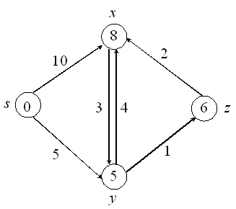
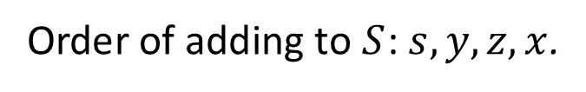
Example:
Order of adding to $S$: $s, y, z, x$.

Slide 46
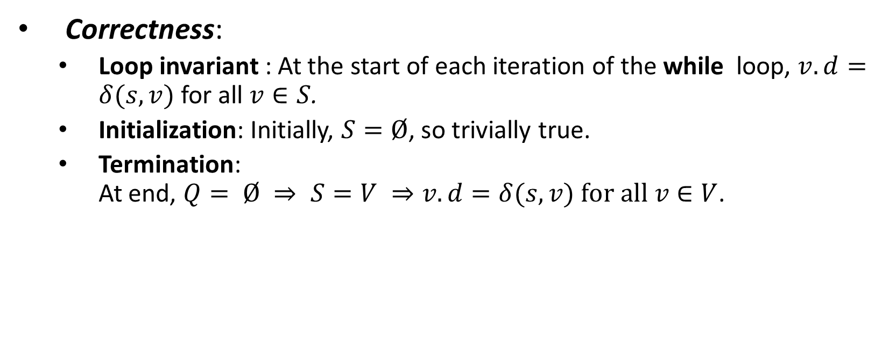
Correctness:
Loop invariant : At the start of each iteration of the while loop, $v.d=δ(s, v)$for all $v∈S$.
Initialization: Initially, $S=Ø$, so trivially true.
Termination: At end, $Q= Ø ⇒ S=V ⇒v.d=δ(s, v) for all v∈V$.

Slide 47
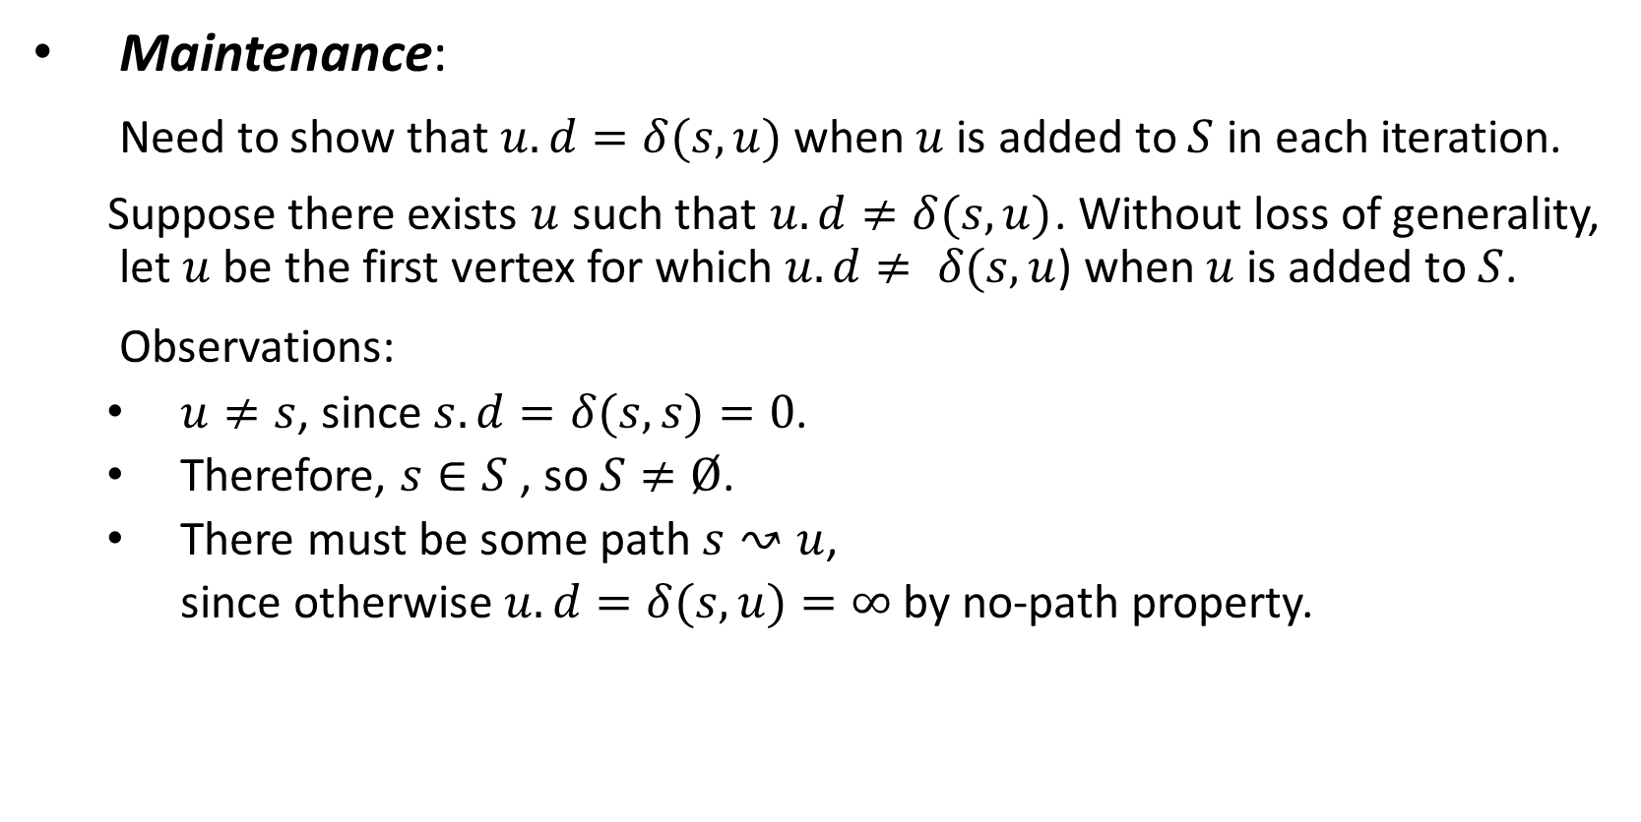
Maintenance:
Need to show that $u.d=δ(s,u)$ when $u$ is added to $S$ in each iteration.
Suppose there exists $u$ such that $u.d≠δ(s,u)$. Without loss of generality, let $u$ be the first vertex for which $u.d≠ δ(s,u$) when $u$ is added to $S$.
Observations:
$u≠s$, since $s.d=δ(s,s)=0$.
Therefore, $s∈S$ , so $S≠Ø$.
There must be some path $s↝u$,
since otherwise $u.d=δ(s,u)=∞$by no-path property.

Slide 48

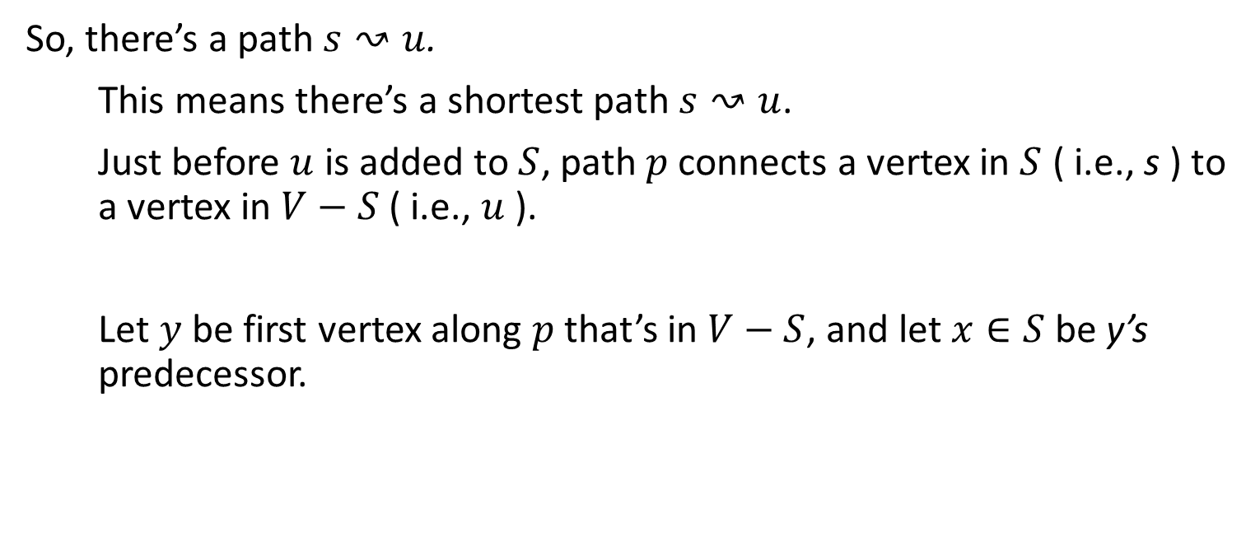
So, there’s a path $s↝u$.
This means there’s a shortest path $s↝u$.
Just before $u$ is added to $S$, path $p$ connects a vertex in $S$ ( i.e., s ) to a vertex in $V−S$ ( i.e., $u$ ).
Let $y$ be first vertex along $p$ that’s in $V−S$, and let $x∈S$ be y’s predecessor.
$$p$$

Slide 49

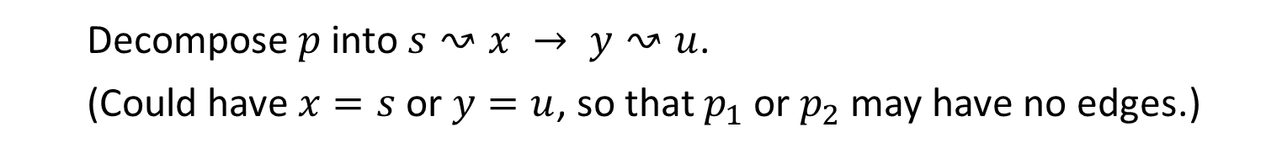

$$p_{1}$$
$$p_{2}$$
Decompose $p$ into $s↝x → y↝u$.
(Could have $x=s$or $y=u$, so that $p_{1}$ or $p_{2}$ may have no edges.)

Slide 50
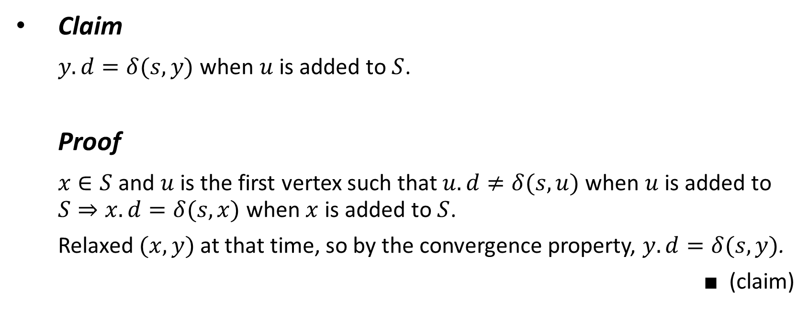
Claim
$y.d=δ(s,y)$ when $u$ is added to $S$.
Proof
$x∈S$and $u$ is the first vertex such that $u.d≠δ(s,u)$ when $u$ is added to $S⇒x.d=δ(s,x)$when $x$ is added to $S$.
Relaxed $(x,y)$at that time, so by the convergence property, $y.d=δ(s,y)$.
■ (claim)

Slide 51
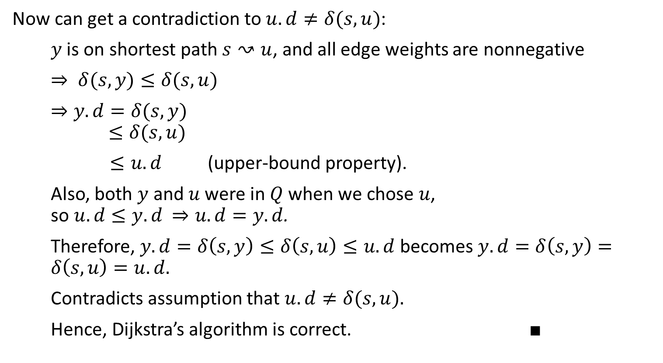
Now can get a contradiction to $u.d≠δ(s,u)$:
$y$ is on shortest path $s↝u$, and all edge weights are nonnegative
$⇒ δ(s,y)≤δ(s,u)$
$⇒y.d=δ(s,y)$
$$≤δ(s,u)$$
$≤u.d$ (upper-bound property).
Also, both $y$ and $u$ were in $Q$ when we chose $u$, so $u.d≤y.d$ $⇒u.d=y.d$.
Therefore, $y.d=δ\left(s,y\right)≤δ\left(s,u\right)≤u.d$ becomes $y.d=δ\left(s,y\right)=δ\left(s,u\right)=u.d.$
Contradicts assumption that $u.d≠δ(s,u).$
Hence, Dijkstra’s algorithm is correct. ■

Slide 52
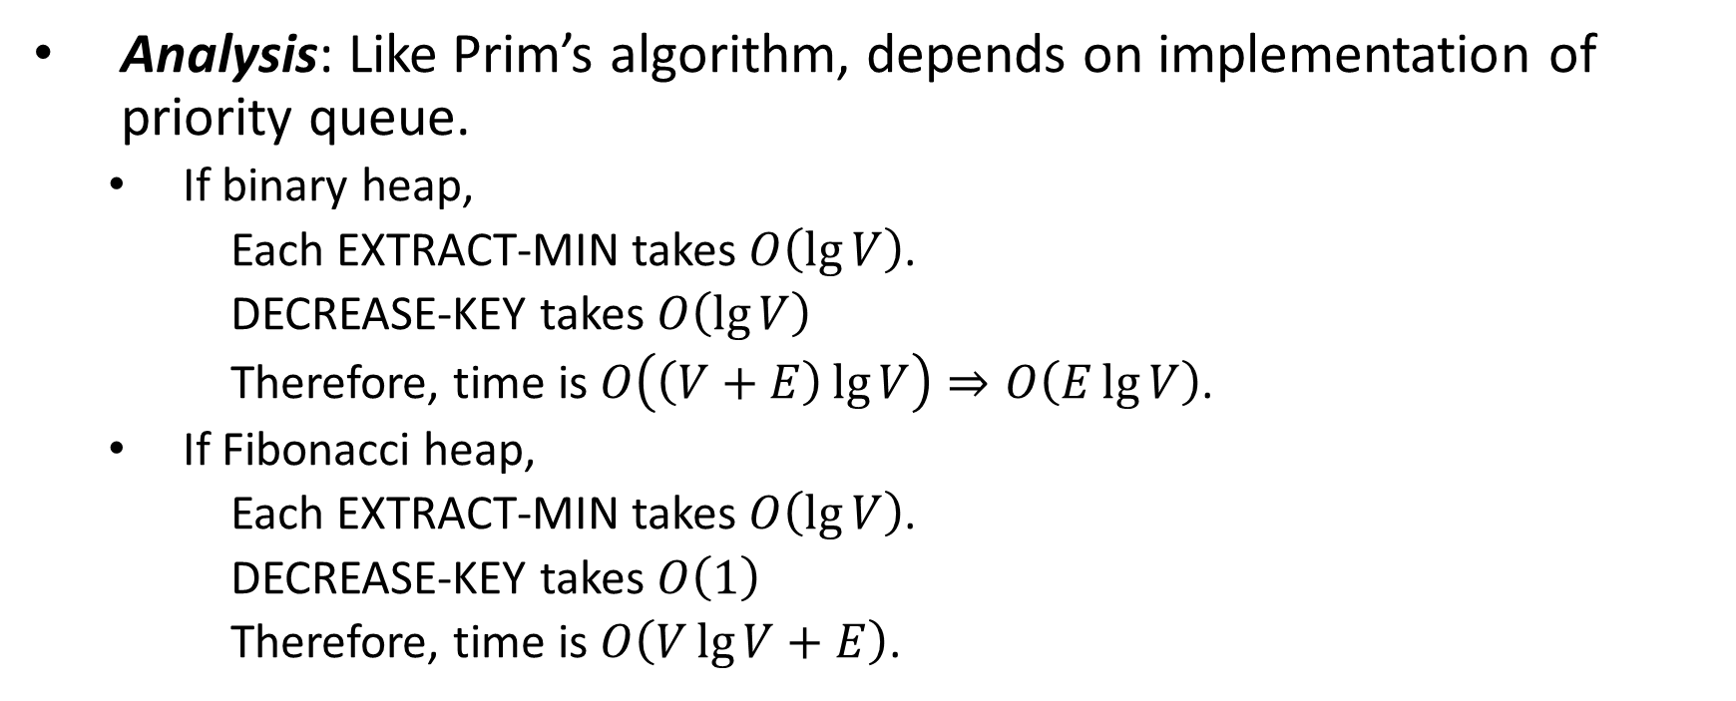
Analysis: Like Prim’s algorithm, depends on implementation of priority queue.
If binary heap,
Each EXTRACT-MIN takes $O\left(\lg{V}\right)$.
DECREASE-KEY takes $O\left(\lg{V}\right)$
Therefore, time is $O\left(\left(V+E\right)\lg{V}\right)⇒O\left(E\lg{V}\right)$.
If Fibonacci heap,
Each EXTRACT-MIN takes $O\left(\lg{V}\right)$.
DECREASE-KEY takes $O\left(1\right)$
Therefore, time is $O\left(V\lg{V}+E\right)$.

Slide 53
Difference constraints

Slide 54

Difference constraints
Given a set of inequalities of the form $x_{j}−x_{i}≤b_{k}$.
$x$’s are variables, $1≤i, j≤n$,
$b$’s are constants, $1≤k≤m$.
Want to find a set of values for the $x$’s that satisfy all $m$ inequalities, or determine that no such values exist.
Call such a set of values a feasible solution.

Slide 55

$$\left(\begin{matrix}1 & −1 & 0 & 0 & 0 \\ 1 & 0 & 0 & 0 & −1 \\ 0 & 1 & 0 & 0 & −1 \\ −1 & 0 & 1 & 0 & 0 \\ −1 & 0 & 0 & 1 & 0 \\ 0 & 0 & −1 & 1 & 0 \\ 0 & 0 & −1 & 0 & 1 \\ 0 & 0 & 0 & −1 & 1\end{matrix}\right)\left(\begin{matrix}x_{1} \\ x_{2} \\ x_{3} \\ x_{4} \\ x_{5}\end{matrix}\right)≤\left(\begin{matrix}0 \\ −1 \\ 1 \\ 5 \\ 4 \\ −1 \\ −3 \\ −3\end{matrix}\right)$$
$$x_{1}−x_{2}≤0$$
$$x_{1}−x_{5}≤−1$$
$$x_{2}−x_{5}≤1$$
$$x_{3}−x_{1}≤5$$
$$x_{4}−x_{1}≤4$$
$$x_{4}−x_{3}≤−1$$
$$x_{5}−x_{3}≤−3$$
$$x_{5}−x_{4}≤−3$$

Slide 56

Example:
Solution: $x=(−5, −3, 0, −1, −4)$
Also: $x=(0, 2, 5, 4, 1)=[above solution]+5$

Slide 57

Lemma 24.8
If $x$ is a feasible solution, then so is $x+d$for any constant d.
Proof
$x$ is a feasible solution
⇒ $x_{j}−x_{i}≤b_{k}$ for all $i$, $j$ ,$k$.
⇒ $(x_{j}+d)−(x_{i}+d)≤b_{k}$. ■ (lemma)

Slide 58

Constraint graph
$G=(V,E),$weighted, directed.
$V=\left\langle v_{0},v_{1},…,v_{k}\right\rangle$ : one vertex per variable ${+v}_{0}$
$E=\left\{\left(v_{i},v_{j}\right):x_{j}−x_{i}≤b_{k} is a constraint\right\}∪\{\left(v_{0},v_{1}\right),\left(v_{0},v_{2}\right),…,\left(v_{0},v_{n}\right)\}$
${w(v}_{0, }v_{i})=0$for all $j$
${w(v}_{i, }v_{j})=b_{k}$ if $x_{j}−x_{i}≤b_{k}$

Slide 59

Theorem
Given a system of difference constraints, let $G=(V,E)$ be the corresponding Constraint graph.
1. If $G$ has no negative-weight cycles, then $x=(δ\left(v_{0},v_{1}\right),δ\left(v_{0},v_{2}\right)$,…,$δ\left(v_{0},v_{n}\right))$ is a feasible solution.
2. If $G$ has a negative-weight cycle, then there is no feasible solution.

Slide 60

Proof
1. Show no negative-weight cycles ⇒ feasible solution.
Need to show that $x_{j}−x_{i}≤b_{k}$ for all constraints. Use $x_{j}=δ\left(v_{0},v_{j}\right)$ $x_{i}=δ\left(v_{0},v_{i}\right)$ $b_{k}=w\left(v_{i},v_{j}\right)$
By the triangle inequality, $δ\left(v_{0},v_{j}\right)≤δ\left(v_{0},v_{i}\right)+w\left(v_{i},v_{j}\right)$ $x_{j}≤x_{i}+b_{k}$ ${{x_{j}−x}_{i}≤b}_{k}$
Therefore, feasible.

Slide 61

2. Show negative-weight cycles ⇒ no feasible solution.
Without loss of generality, let a negative-weight cycle be
$C=\left\langle v_{0},v_{1},…,v_{k}\right\rangle$where $v_{1}=v_{k}$ ($v_{0}$can’t be on $C$, since $v_{0}$ has no entering edges.) $C$ corresponds to the constraints
$$x_{2}−x_{1}≤w(v_{1},v_{2})$$
$$x_{3}−x_{2}≤w(v_{2},v_{3})$$
…
$$x_{k−1}−x_{k−2}≤w(v_{k−2},v_{k−1})$$
$$x_{k}−x_{k−1}≤w(v_{k−1},v_{k})$$
(The last two inequalities above are incorrect in the first three printings of the book. They were corrected in the fourth printing.)

Slide 62

If $x$ is a solution satisfying these inequalities, it must satisfy their sum.
So add them up.
Each $x_{i}$ is added once and subtracted once. $(v_{1}=v_{k}⇒x_{1}=x_{k})$
We get $0≤ w(C).$
But $w(C)<0$, since $C$ is a negative-weight cycle.
Contradiction ⇒ no such feasible solution $x$ exists.
■ (theorem)

Slide 63

How to find a feasible solution
1. Form constraint graph.
$n+1$vertices.
$m+n$ edges.
$Θ(m+n)$ time.
2. Run BELLMAN-FORD from $v_{0}$ .
$O(VE)=O((n+1)(m+n))=O(n^{2}+nm)$time.
3. If BELLMAN-FORD returns FALSE ⇒ no feasible solution.
If BELLMAN-FORD returns TURE
⇒ set $x_{i}=δ(v_{0},v_{i})$ for all $i$.

